Slide 1
Universal Adaptor Signatures from Blackbox Multi-Party Computation
CRYP-W08
Michele Ciampi, Xiangyu Liu, Ioannis Tzannetos, Vassilis Zikas
Dr. Xiangyu Liu University of Edinburgh & Purdue University & NTUA & Georgia Tech

Slide 2
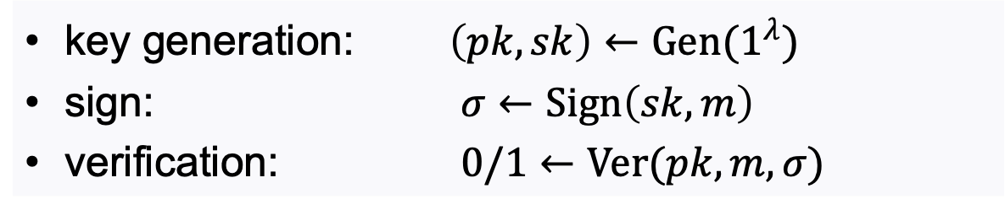
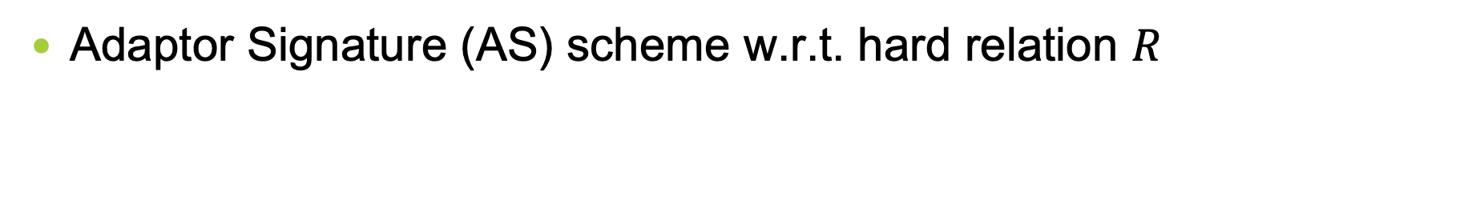
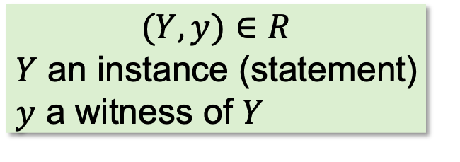
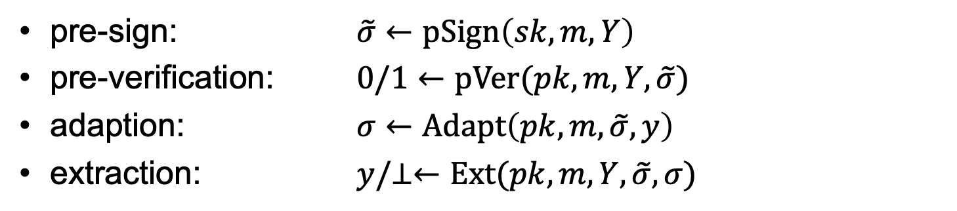
(Adaptor) Signatures
Signature scheme:
key generation: $\left(pk, sk\right)←Gen(1^{λ})$
sign: $σ←Sign\left(sk, m\right)$
verification: $0/1←Ver(pk,m,σ)$
Adaptor Signature (AS) scheme w.r.t. hard relation $R$
pre-sign: $\tilde{σ}←pSign\left(sk,m,Y\right)$
pre-verification: $0/1←pVer(pk,m,Y,\tilde{σ})$
adaption: $σ←Adapt\left(pk,m,\tilde{σ},y\right)$
extraction: $y/⊥←Ext(pk,m,Y,\tilde{σ},σ)$
$$(Y,y)∈R$$
$Y$ an instance (statement)
$y$ a witness of $Y$

Slide 3



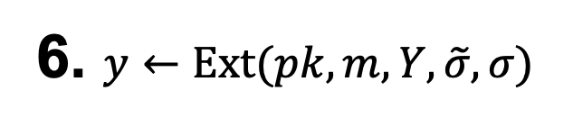

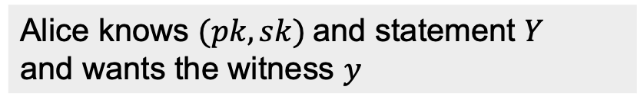
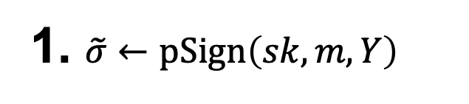

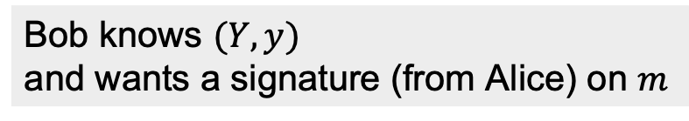

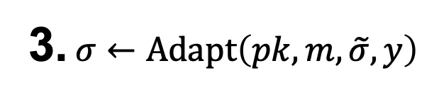
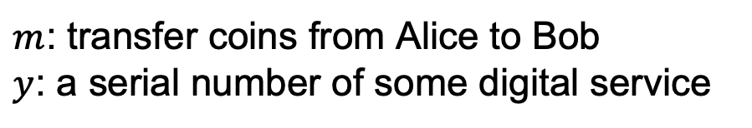
AS for Fair Exchange
6. $y←Ext(pk,m,Y,\tilde{σ},σ)$
5. Read $σ$
Public Bulletin Board
4. Upload $m,σ$
2. Transfer $\tilde{σ}$
Alice
Bob
1. $\tilde{σ}←pSign\left(sk,m,Y\right)$
3. $σ←Adapt\left(pk,m,\tilde{σ},y\right)$
Alice knows $(pk, sk)$and statement $Y$
and wants the witness $y$
Bob knows $(Y,y)$
and wants a signature (from Alice) on $m$
$m$: transfer coins from Alice to Bob
$y$: a serial number of some digital service
3

Slide 4


More Applications of AS
Atomic swap
Multi-hop payments
ETH
$y$
$y$
Alice
Bob
Alice
Bob
Samkie
BTC
BTC
BTC

Slide 5


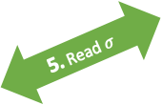

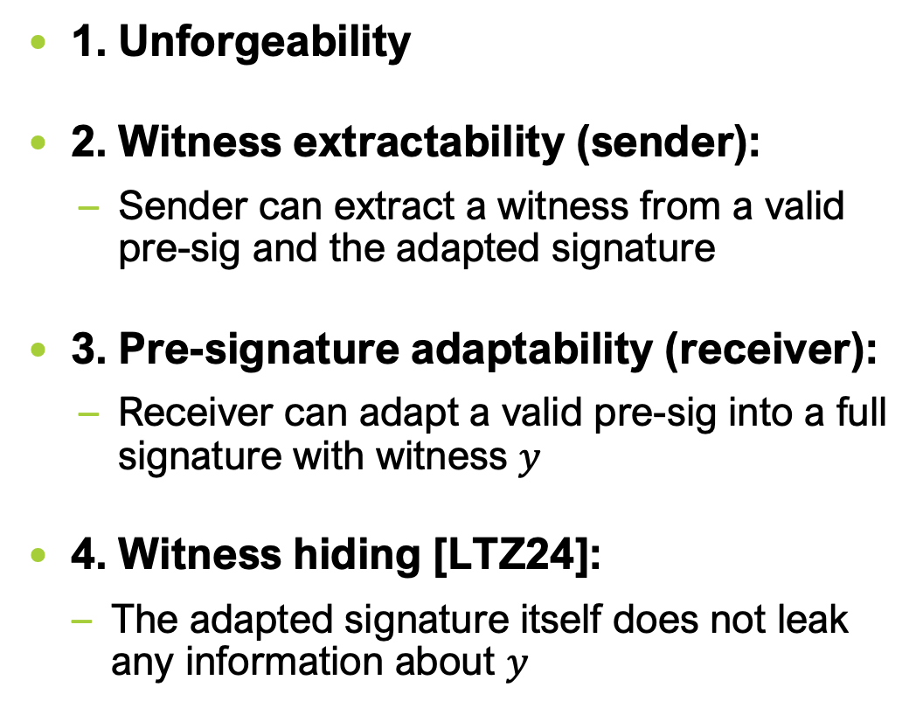




Security of AS
1. Unforgeability
2. Witness extractability (sender):
Sender can extract a witness from a valid pre-sig and the adapted signature
3. Pre-signature adaptability (receiver):
Receiver can adapt a valid pre-sig into a full signature with witness $y$
4. Witness hiding [LTZ24]:
The adapted signature itself does not leak any information about $y$
6. $y←Ext(pk,m,Y,\tilde{σ},σ)$
5. Read $σ$
Public Bulletin Board
4. Upload $m,σ$
2. Transfer $\tilde{σ}$
Bob
Alice
1. $\tilde{σ}←pSign\left(sk,m,Y\right)$
3. $σ←Adapt\left(pk,m,\tilde{σ},y\right)$
Alice knows $(pk, sk)$and statement $Y$
and wants the witness $y$
Bob knows $(Y,y)$
and wants a signature (of Alice) on $m$

Slide 6
Related Works
Concrete AS schemes
ECDSA-based AS [AEE+21 (ASIACRYPT)]
Schnorr-based AS [AEE+21 (ASIACRYPT), TZC22 (ISC)]
LWE/SIS-based scheme LAS [EEE20 (ESORICS)]
Code-based scheme AS [KH22 (Cryptography)]
Isogeny-based scheme IAS [TMM21 (FC)]
Identification-based AS [EFH+21 (PKC)]
AS from CL, BBS+, Waters signatures [GSST24 (EUROCRYPT)]
for a specific Sig scheme and a corresponding language
Universal Adaptor Signature (UAS) schemes for any NP language
GAS1 [DOY22 (INDOCRYPT)] ------no witness hiding!
Hamiltonian Cycle-based scheme [LTZ24 (ASIACRYPT)]

Slide 7
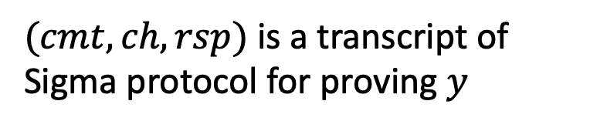
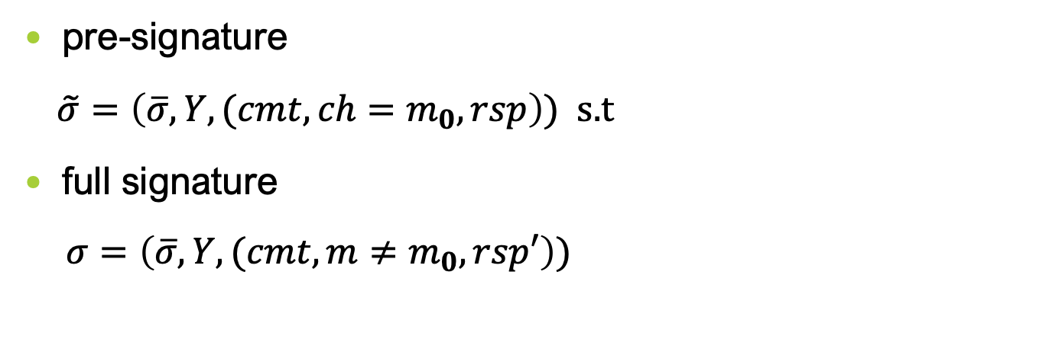
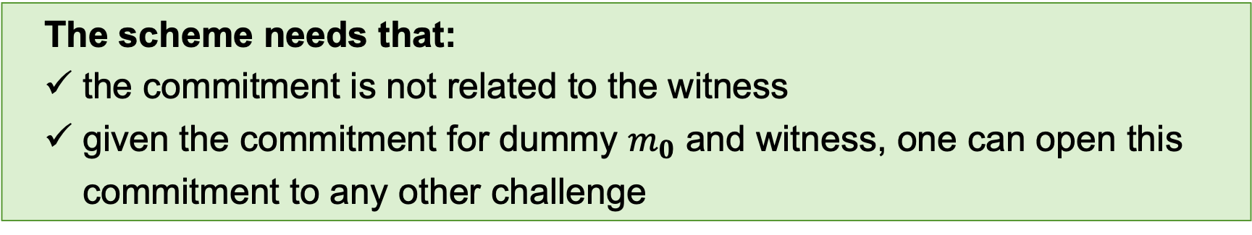
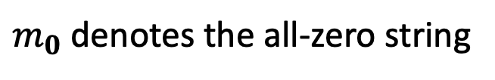

[LTZ24]’s Scheme
$$\overline{σ}←SIG.Sign\left(sk,\left(m,Y,cmt\right)\right)$$
pre-signature
$\tilde{σ}=\left(\overline{σ},Y,(cmt,{ch=m}_{0},rsp\right))$ s.t
full signature
$σ=\left(\overline{σ},Y,(cmt,m≠m_{0},rsp′\right))$
$m_{0}$ denotes the all-zero string
$(cmt, ch, rsp)$is a transcript of Sigma protocol for proving $y$
The scheme needs that:
the commitment is not related to the witness
given the commitment for dummy $m_{0}$ and witness, one can open this commitment to any other challenge
Does such Sigma protocol exist?
---Yes! Blum’s Sigma Protocol for Hamiltonian Cycle!

Slide 8



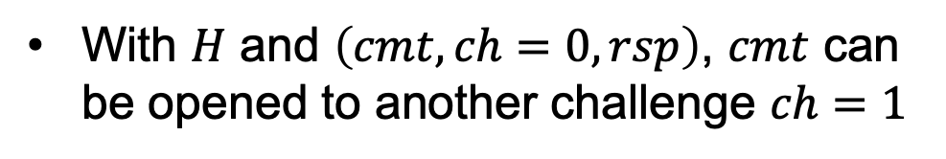





Blum’s Sigma Protocol for Hamiltonian Cycle
$${cmt}_{π(G)}$$
$$ch=0$$
$$ch=1$$
Prover
$$rsp=(π,d_{π(G)})$$
$$rsp=(π(H),d_{π(H)})$$
Verifier
$$(G,H)$$
$$(G)$$
$d$: the opening of a commitment
The commitment is not related to the witness
With $H$ and $\left(cmt, ch=0,rsp\right)$, $cmt$ can be opened to another challenge $ch=1$

Slide 9
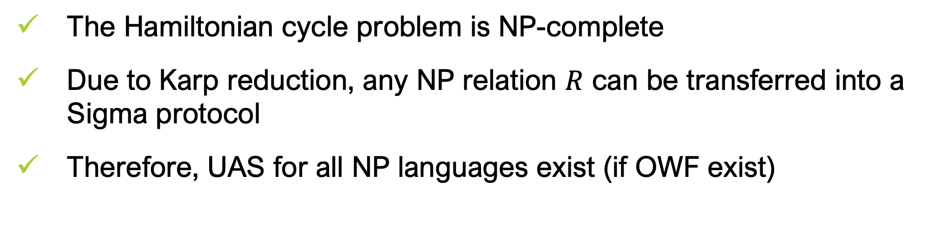
[LTZ24]’s Scheme
The Hamiltonian cycle problem is NP-complete
Due to Karp reduction, any NP relation $R$ can be transferred into a Sigma protocol
Therefore, UAS for all NP languages exist (if OWF exist)
Nice, but…
Karp reduction is too heavy. Can we do better? Like, MPC in the head?

Slide 10
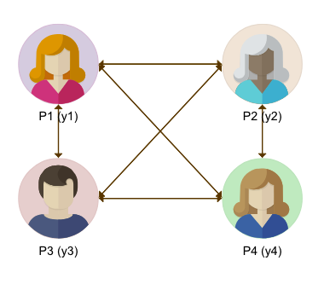
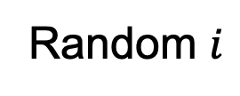
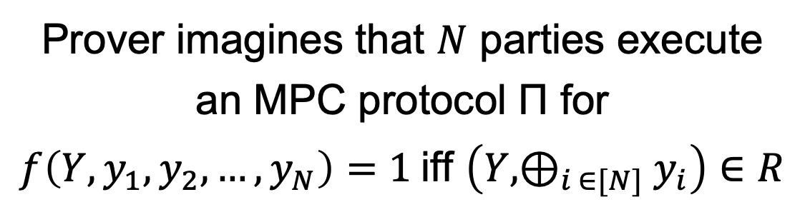
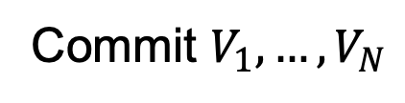


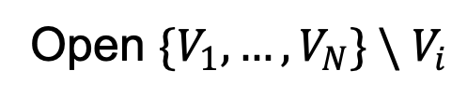
MPC-in-the-head [IKOS07]
Commit $V_{1},…,V_{N}$
Random $i$
Prover
Open ${\{V}_{1},…,V_{N}\} \backslash V_{i}$
Verifier
$$(Y,y)$$
$$(Y)$$
Prover imagines that $N$ parties execute an MPC protocol Π for $f\left(Y,y_{1},y_{2},…,y_{N}\right)=1$iff $\left(Y,⊕_{i ∈[N]}y_{i}\right)∈R$

Slide 11
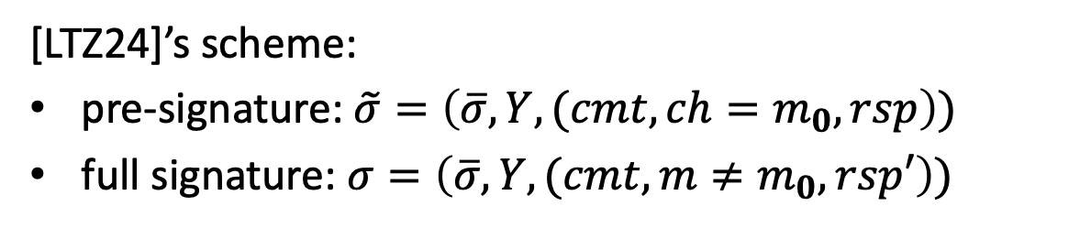
Problem of Using MPCitH
In MPC-in-the-head, the commitment depends on the witness.
However, in pre-signing, only statement Y is known but not the witness.
[LTZ24]’s scheme:
pre-signature: $\tilde{σ}=\left(\overline{σ},Y,(cmt,{ch=m}_{0},rsp\right))$
full signature: $σ=\left(\overline{σ},Y,(cmt,m≠m_{0},rsp′\right))$

Slide 12

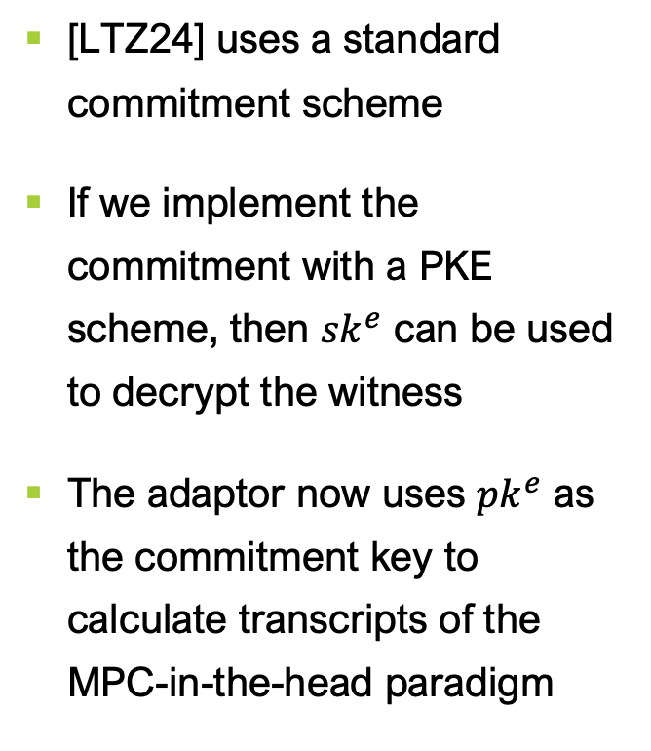



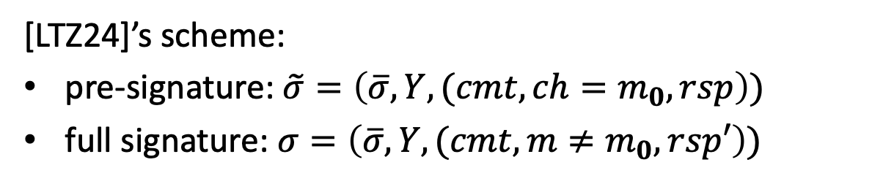
Our Solution
[LTZ24]’s scheme:
pre-signature: $\tilde{σ}=\left(\overline{σ},Y,(cmt,{ch=m}_{0},rsp\right))$
full signature: $σ=\left(\overline{σ},Y,(cmt,m≠m_{0},rsp′\right))$
[LTZ24] uses a standard commitment scheme
If we implement the commitment with a PKE scheme, then ${sk}^{e}$ can be used to decrypt the witness
The adaptor now uses ${pk}^{e}$ as the commitment key to calculate transcripts of the MPC-in-the-head paradigm
Our solution:
Pre-signature: $\tilde{σ}=\left(\overline{σ},Y,({pk}^{e},{sk}^{e}\right))$
Full signature: $σ=\left(\overline{σ},Y,{pk}^{e},π\right)$
---$π$ is the zero-knowledge proof based on MPCitH with ${pk}^{e}$ the commitment key
$$Commit\left(m\right): c=PKE.Enc\left({pk}^{e},m;r\right)$$
$$Open\left(c\right):Return \left(m,r\right) and check if$$
$$c=PKE.Enc\left({pk}^{e},m;r\right)$$

Slide 13
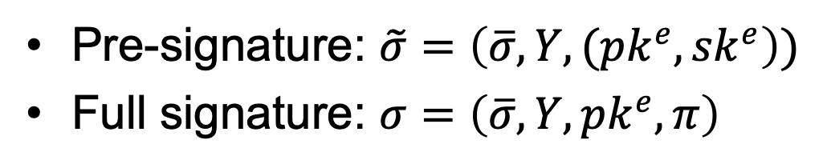
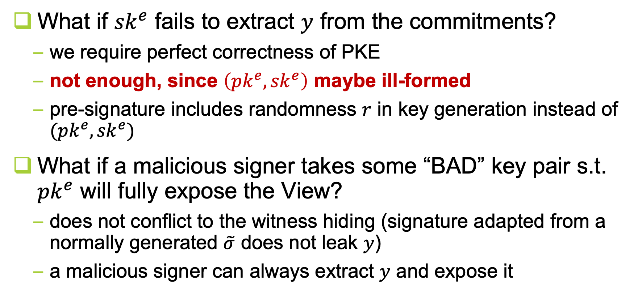
Some Subtleties
Pre-signature: $\tilde{σ}=\left(\overline{σ},Y,({pk}^{e},{sk}^{e}\right))$
Full signature: $σ=\left(\overline{σ},Y,{pk}^{e},π\right)$
What if ${sk}^{e}$ fails to extract $y$ from the commitments?
we require perfect correctness of PKE
not enough, since $\left({pk}^{e},{sk}^{e}\right)$ maybe ill-formed
pre-signature includes randomness $r$ in key generation instead of $({pk}^{e},{sk}^{e})$
What if a malicious signer takes some “BAD” key pair s.t. ${pk}^{e}$ will fully expose the View?
does not conflict to the witness hiding (signature adapted from a normally generated $\tilde{σ}$ does not leak $y$)
a malicious signer can always extract $y$ and expose it

Slide 14
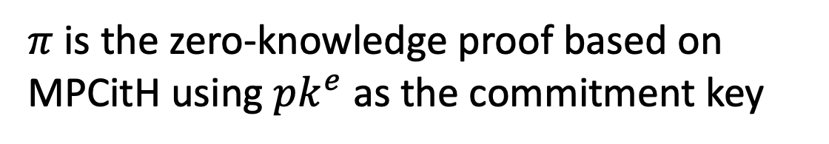



Our Scheme
pre-signature
$\tilde{σ}=(\overline{σ},r)$ s.t.
full-signature
$σ=\left(\overline{σ},Y,{pk}^{e},π\right))$
Extract
recompute ${sk}^{e}$ and extract $y$ from $π$
$$\left({pk}^{e},{sk}^{e}\right)←PKE.Kgen(1^{λ};r)$$
$$\overline{σ}←SIG.Sign\left(sk,\left(m,Y,{pk}^{e}\right)\right)$$
$π$ is the zero-knowledge proof based on MPCitH using ${pk}^{e}$ as the commitment key

Slide 15










Applications & Conclusion
Efficient universal adaptor signatures (UAS) from MPCitH
Enhance the applicability of decentralized applications from AS
6. $y←Ext(pk,m,Y,\tilde{σ},σ)$
5. Read σ
Public Bulletin Board
4. Upload $m,σ$
Alice
2. Transfer $\tilde{σ}$
Bob
1. $\tilde{σ}←pSign\left(sk,m,Y\right)$
3. $σ←Adapt\left(pk,m,\tilde{σ},y\right)$
Our work
Alice knows $(pk, sk)$and statement $Y$
and wants the witness $y$
Bob knows $(Y,y)$
and wants a signature (of Alice) on $m$
efficient UAS
Decentralized Apps
MPC

Slide 16
References
[TZC22] Tu, B., Zhang, M., & Yu, C. (2022). Efficient ECDSA-based adaptor signature for batched atomic swaps. In ISC 2022.
[EEE20] Esgin, M.F., Ersoy, O., & Erkin, Z. (2020). Post-quantum adaptor signatures and payment channel networks. In ESORICS 2020.
[TMM21] Tairi, E., Moreno-Sanchez, P., & Maffei, M. (2021). Post-quantum adaptor signature for privacy-preserving off-chain payments. In FC 2021.
[KH22] Klamti, J.B., & Hasan, M.A. (2022). Post-quantum two-party adaptor signature based on coding theory. Cryptography, 6(1), 6.
[EFH+21] Erwig, A., Faust, S., Hostáková, K., Maitra, M., & Riahi, S. (2021). Two-party adaptor signatures from identification schemes. In PKC 2021.
[DOY22] Dai, W., Okamoto, T., & Yamamoto, G. (2022). Stronger security and generic constructions for adaptor signatures. In INDOCRYPT 2022.
[GSST24] Gerhart, P., Schröder, D., Soni, P., & Thyagarajan, S.A.K. (2024). Foundations of adaptor signatures. In EUROCRYPT 2024.
[LTZ24] Liu, X., Tzannetos, I., & Zikas, V. (2024). Adaptor signatures: New security definition and a generic construction for NP relations. In ASIACRYPT 2024.
[IKOS07] Ishai, Y., Kushilevitz, E., Ostrovsky, R., & Sahai, A. (2007). Zero-knowledge from secure multiparty computation. In STOC 2007.

Slide 17
Thank You!
For more information:
https://eprint.iacr.org/2024/1773

